Slide 1
Alzheimer’s Disease
Neuro 3

Slide 2
Watch this brief intro video
https://www.youtube.com/watch?v=yJXTXN4xrI8

Slide 3
Alzheimer’s Disease (AD)
Degenerative brain disease
Leading cause of dementia
Dementia is a syndrome (group of symptoms) that has a number of different causes
Symptoms include difficulties with memory, language, problem-solving and other cognitive skills that affect a person’s ability to perform everyday activities
Symptoms occur because neurons involved in cognitive function have been damaged or destroyed
‘plaques and tangles’ primarily in hippocampus and frontal lobe
As AD progresses, neurons in other parts of the brain are also damaged or destroyed
Leading to issues with movement and basic body functions
Notes:
Hippocampus is critical for learning and encoding new info – takes what we are perceiving/being presented with and links it with what we already know/other memories so that we can makes sense of it and store it as new information/new memories

Slide 4
Alzheimer’s Disease (AD)
Alzheimer’s
Accounts for ~70% of dementia cases
Is NOT a normal part of aging
Ultimately fatal
vs. Dementia
Umbrella term for a set of symptoms affecting thinking and memory
Several causes of dementia with AD being the main one
FYI Others of dementia can include hydrocephalus, Creutzfeldt-Jakob disease, Parkinson’s Disease, vascular dementia, etc.

Slide 5
AD
Characterized by death of synapses coupled to death of nerve cells and brain degeneration
First neurons to be damaged/destroyed are usually in brain regions involved in forming new memories
Rate of progression varies from person to person
Mild, moderate, severe

Slide 6
AD
Accumulation of beta-amyloid plaques
Outside neurons
Contribute to cell death by interfering with neuron-to-neuron communication at synapse
Accumulation of an abnormal form of tau protein causes tau tangles
Inside neurons
Block the transport of nutrients and other essential molecules
Brains of people with advanced AD show:
Inflammation
Dramatic shrinkage from cell loss
Widespread debris from dead and dying neurons

Slide 7
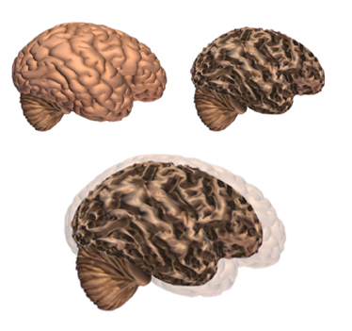
Typical brain vs. AD brain
Notice the marked atrophy
Alzheimer’s Association alz.org

Slide 8
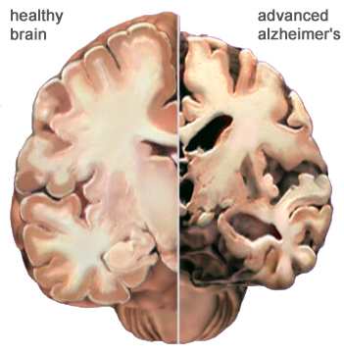
Typical brain vs. AD brain
Notice the marked atrophy

Slide 9
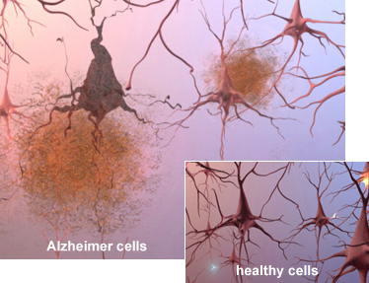
Plaques and tangles

Slide 10
AD
It is predicted that by 2030 roughly 1,000,000 Canadians will have Alzheimer’s
Women over 65 have a 1 in 5 chance of developing Alzheimer’s; males 1 in 11
Women live longer than men and age is biggest risk factor
Alzheimer Society of Canada

Slide 11
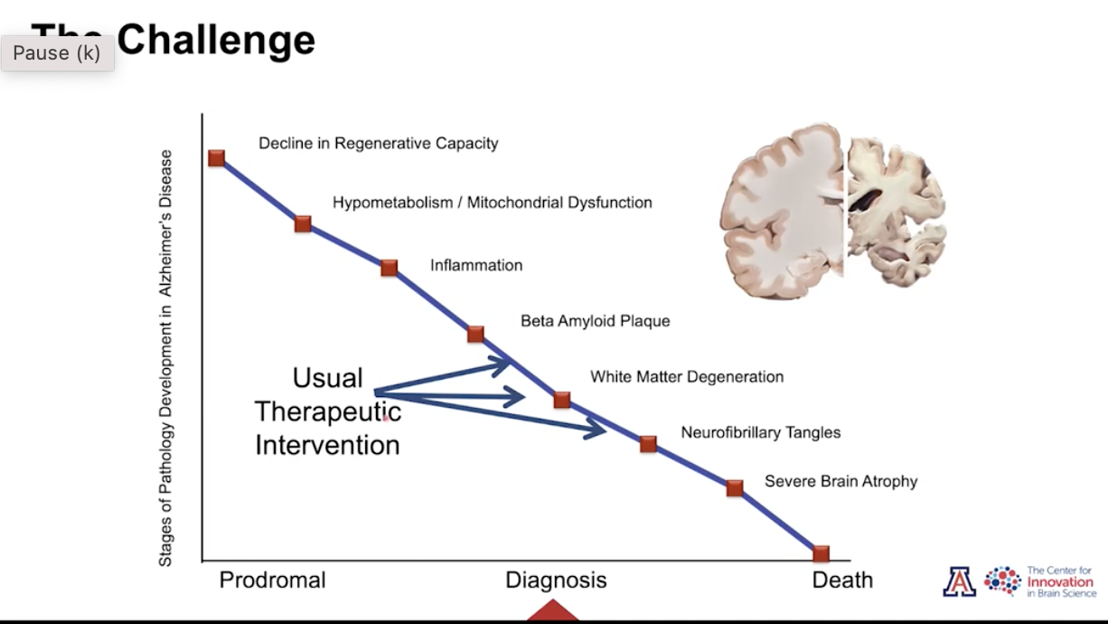
Image from Dr. Roberta Diaz Brinton, 2022 Kaufer Lecture
Notes:
Challenge is that diagnosis often occurs when a lot of degeneration has occurred
Prevention, earlier diagnosis allows for more regenerative approaches

Slide 12
AD
‘Warning’ signs:
Memory changes that disrupt daily life
Word finding difficulties
With writing and/or speaking
Confusion
About a time and/or place
Changes in mood and personality
Decreased judgment about safety
Difficulty with decision making, planning, problem solving
Difficulty completing familiar tasks
Difficulty with spatial relations
Misplacing items and decreased ability to retrace steps
Withdrawal from social and/or work activities
Loss of initiative

Slide 13
AD
“Sundowning”
As Alzheimer’s disease progresses individuals may get lost in once-familiar places
Get restless
Could also see increase in agitation, irritability, confusion
Go out wandering especially in late afternoon/evening
Most likely a combo of disease process and other triggers
E.g,. Unmet needs
Key in managing is exercise and exposure to natural light
Notes:
Potentially linked to part of our brain that controls our ’biological clock’ and altering sleep-wake cycle
Could also just be a way of showing other unmet needs like overtired, anger, thirst, depression

Slide 14
Later stages of AD
Forget how to do ‘simple’ motor tasks
Need help with ADLs
Loss of cognitive capacity paired with loss of physical capacity
Gait and balance issues
In advanced stages patients are dependent on others for ADLs
Many wheel-chair or bed ridden
Ultimately fatal

Slide 15
Alzheimer’s
Risk Factors:
Modifiable:
High BP
High cholesterol
Diabetes
Obesity
Lack of physical activity
Smoking
Excessive Alcohol Intake
Somewhat modifiable:
Low levels of formal education
Head injuries
Depression
Non-modifiable
Age
Family History
Steinberg et al. 2014
Notes:
Consider how increasing physical activity can positively affect all of those modifiable risk factors.

Slide 16
Maintain Brain Health
Be physically active
Avoid smoking and excessive alcohol consumption
Keep blood pressure, cholesterol, blood sugar and weight within recommended ranges
Stay connected socially and interact regularly with others
Make healthy food choices, eat a well-balanced and healthy diet
Reduce stress
Practice good sleep hygiene
Challenge your brain
Protect your head
Eg. wearing a helmet

Slide 17

Neuroprotection in AD
There is no guarantee that changing lifestyle habits to ones that promote brain health will prevent someone from getting AD, but science is showing a large protective effect
Rapidly developing area of research
WATCH What can you do to prevent AD
https://www.youtube.com/watch?v=twG4mr6Jov0

Slide 18
Neuroprotection in AD
Take care of yourself!!!!
Exercise
Especially aerobic
Healthy diet
Sleep
Stress management
Challenge yourself
Learn something new
STIMULATE your brain with novel experiences
Be socially active

Slide 19
Neuroprotection in AD
Physical activity can improve memory
Regular exercise may delay the onset of dementia and AD
May delay decline in ability to perform ADLs
“If exercise could be packaged into a pill, it would be the single most widely prescribed and beneficial medicine in the nation”
Dr. Robert Butler national institute on Aging

Slide 20
Neuroprotection in AD
Physical activity is neuroprotective
Increased brain CV and metabolic health
Improved synapto- ,neuro- and angio- genesis
Reduced inflammation
Improved central and peripheral reserve
The ability to maintain function despite pathology
Phillips 2015, Lucas 2015, Esiri 2012, Erickson 2010

Slide 21
Neuroprotection in AD
Higher physical activity is associated with:
Reduced likelihood of cognitive impairment later in life
Less global cognitive decline
Less mild cognitive impairment

Slide 22
Physiotherapy in AD
What role do you think physiotherapists have in the management of Alzheimer’s Disease?

Slide 23
Physiotherapy in AD
What are some of the unique challenges in providing physiotherapy for individuals with Alzheimer’s Disease?

Slide 24
Dementia Tips
Try to create a routine
Encourage independence
May have to give them task and watch for safety but cue involvement
Keep commands simple
one thing at a time
Allow extra time for responses to questions
If you are not understood, try re-phasing
Avoid dual tasking
Use descriptive reminders
Your husband Toby
Use touch, sound, vision as appropriate to maximize communication

Slide 25
FYI Additional research PT and AD:
Blackwood J, Martin A. Screening for cognitive impairment as a part of falls risk assessment in physical therapist practice. J Geriatr Phys Ther. 2017;40(4):197–203.
Sobol NA, Hoffmann K, Vogel A, et al. Associations between physical function, dual task performance and cognition in patients with mild Alzheimer’s disease. Aging Ment Health. 2016;20(11):1139–1146.
Dawson N, Judge KS, Gerhart H. Improved functional performance in individuals with dementia after a moderate-intensity home-based exercise program: a randomized controlled trial. J Geriatr Phys Ther. 2019;42(1):18–27.
Ries JD, Hutson J, Maralit LA, Brown MB. Group balance training specifically designed for individuals with Alzheimer disease: impact on Berg Balance Scale, Timed Up and Go, Gait Speed, and Mini-Mental Status Examination. J Geriatr Phys Ther. 2015;38(4):183–193

Slide 26
Resources
Administering and Scoring Cognitive Screening Instruments (MiniCog, SLUMS, MoCA)
www.actonalz.org/provider-practice-tools
Great resource for therapists and caregivers for working with dementia:
https://www.vha.ca/dementia-care/heart-in-mind/
https://www.vha.ca/wp-content/uploads/2020/09/Heart-in-Mind-September-2020-Final-1.pdf
Falls Risk in AD: Patient guide:
https://www.archives-pmr.org/article/S0003-9993(20)30075-7/fulltext
Toolkit for AD patients:
https://www.brightfocus.org/alzheimers

Slide 27
Follow is a case study just FYI for your review and learning

Slide 28
Treatment Planning Case Study
Marcy Pollard is a 72 year old woman who you see in the community through your mobile clinic. She moved into an Assisted Living Facility after being diagnosed with Alzheimer’s 2 years ago. She has been referred to you as she is “deconditioned” and has had a few falls at her assisted living facility over the last few months. She has yet to sustain any serious injuries from her falls, but her family is concerned that it is only a matter of time before she seriously injures herself. Her spatial awareness and balance have been declining over the last few years. She also lives a pretty sedentary life. She spends most of her time watching Television and flipping through magazines. She does not participate in any of the group activities at her facility, and for the most part keeps to herself.
She is independent with all her ADLs (except for medication management) and her family/facility assists with all IADLs.
Who is she: a widow and mother of 3, she previously worked as a care aid prior to her diagnosis, she used to lead a vibrant social life and enjoyed seeing live music with her husband before he passed, dancing, entertaining friends, and teaching Tai Chi at the community centre. She also used to attend yoga classes and was involved in a hiking group.
You ask Marcy’s family and the staff at her facility when/where the falls happen, what precedes the falls, and which direction the falls usually happen. The only information they have is that the falls happen later in the afternoon in Marcy’s suite and usually in the bathroom or the kitchen. Her bathroom is fully equipped with adaptive equipment. She has linoleum throughout her suite. Marcy is able to remember that she has had some falls but is not able to give you much insight as to why she is falling.
Cognitively, Marcy is still able to follow 1-2 step motor commands. She can still complete familiar tasks but has difficulty learning new motor tasks. That said, she does well carrying out a task if you provide visual demonstration.

Slide 29
Clinical observation/Assessment: Ambulates with a 4WW with slow gait speed with decreased step-length bilaterally and increased base of support both during gait and when standing Atypical postural alignment – increased trunk flexion and hip flexion, head forward Decreased trunk/head and neck movement during gait Unable to reach more than 20cm forward or laterally without support when in bathroom and kitchen Unable to stand from standard height chair without use of upper extremities Independent with bed mobility/transfers using upper extremities Independent with ambulation with 4WW in suite and facility. Standby assist for community ambulation | Outcome measures 38/56 on the Berg Balance Scale 13.2 seconds to complete the TUG 276m on the 6MWT (for which she was notably winded)

Slide 30
Diagnosis: Alzheimer's disease affecting cognition, gait and balance
Sample treatment Goal: Marcy will be able to walk for 3 songs with 1 minute rest break in between each song as she listens to her favorite band the Ronettes at a speed greater than 47m/minute
Impairments to be treated: Decreased gait speed and cardiovascular endurance. Decreased engagement in past hobbies and interests
Pre-test: You had administered your 6MWT and she was only able to cover 46m/minute (276m in 6 minutes)
Treatment Sequence: See next slide
Notes:
You will administer your post-test when appropriate (ie. After you have worked with your client for a few weeks)

Slide 31
Example Treatment Sequence
Treatment sequence
Rationale
Start Marcy on the stationary bike in her facility’s gym for short warm-up while you listen to a mix CD that her family has made with all her favourite songs
Standing balance work using Tai Chi Warm-up exercises
Moderate paced walking while listening to some upbeat music from her mixed CD
Tai Chi cool down sequence
Decreased cardiovascular endurance, decreased participation in past hobbies (listening to music)
Decreased balance, decreased trunk/head/neck rotation, decreased participation in past hobbies
Decreased gait speed, decreased cardiovascular endurance, decreased participation in past hobbies
Decreased balance, decreased trunk/head/neck rotation, decreased participation in past hobbies

Slide 32
Now it is your turn!
Come up with a new SMART treatment goal
Feel free to work on some of the same impairments, just make sure you identify what you plan on working on.
Identify a pre-test (it doesn’t necessarily need to be one of the outcome measures administered)
Come up with a treatment sequence and rationale
Be creative! Your treatment could involve getting her engaged her facilities programming, modifying her living environment, working on balance, endurance etc.
List a few considerations you thought about when coming up with your treatment plan?
For example, I used Tai Chi sequences to structure my balance work as this is a previously learned motor skill that Marcy might be able to tap into.
Notes:
Work in groups of 2-3. You have 15 minutes to work through these questions. It does not have to be perfect! You have all had placements and have likely worked with someone with Alzheimer's. Pull from your patient and client experiences when thinking about your treatment planning.

